Slide 1
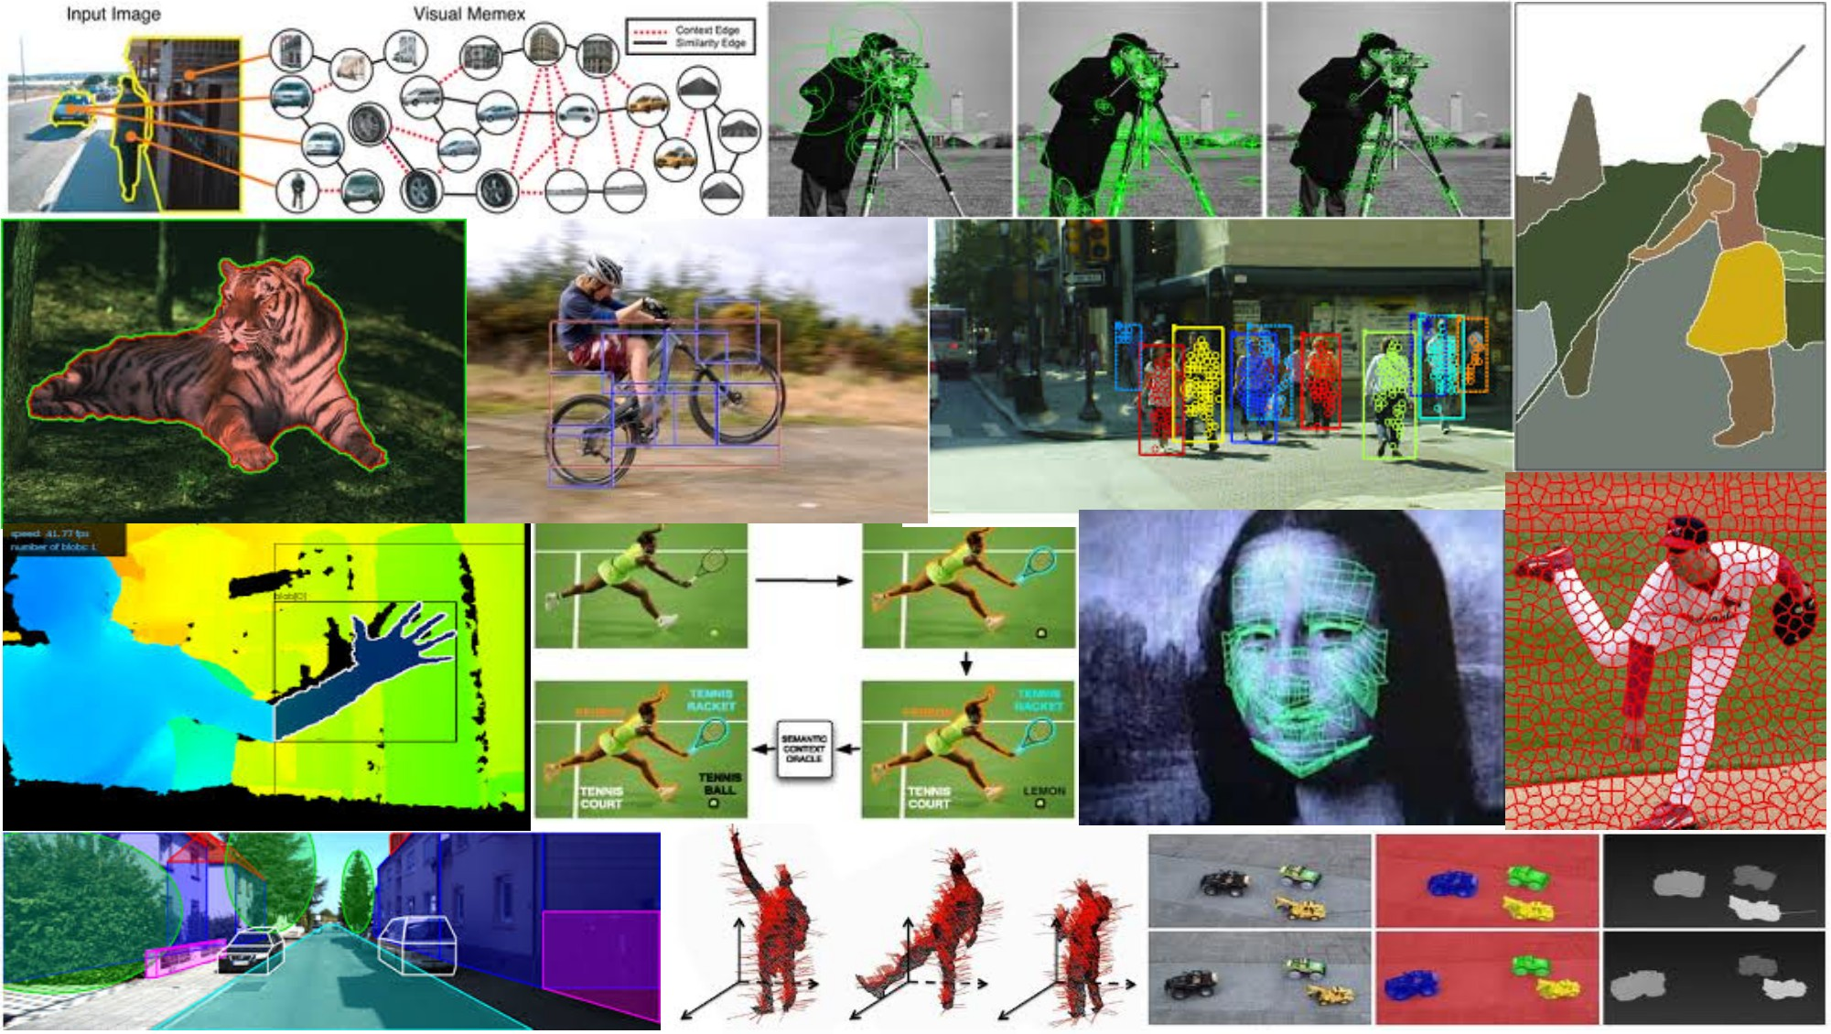
Linear Filters April 5th, 2018
Yong Jae Lee
UC Davis

Slide 2
Announcements
PS0 out today; due 4/13 Friday at 11:59 pm
Carefully read course website
Sign-up for piazza

Slide 3
Plan for today
Image formation
Image noise
Linear filters
Examples: smoothing filters
Convolution / correlation

Slide 4

Image Formation
Slide credit: Derek Hoiem

Slide 5
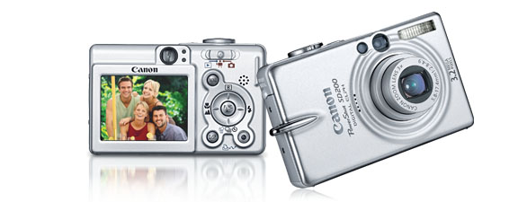
Digital camera
A digital camera replaces film with a sensor array
Each cell in the array is light-sensitive diode that converts photons to electrons
http://electronics.howstuffworks.com/digital-camera.htm
Slide credit: Steve Seitz

Slide 6

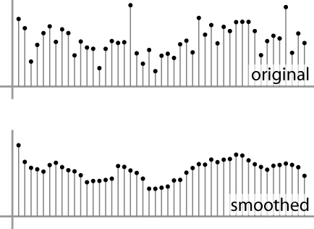
Digital images
Sample the 2D space on a regular grid
Quantize each sample (round to nearest integer)
Image thus represented as a matrix of integer values.
2D
1D
Slide credit: Kristen Grauman, Adapted from Steve Seitz

Slide 7
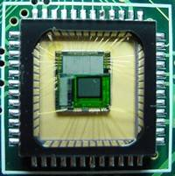

Digital images
CMOS sensor
Slide credit: Derek Hoiem
Notes:
Semiconductor that records light electronically
Each sensor cell records amount of light coming in at a small range of orientations

Slide 8
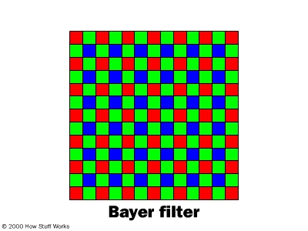
Digital color images
Slide credit: Kristen Grauman
Notes:
Unfortunately, each photosite is colorblind. It only keeps track of the total intensity of the light that strikes its surface.
In order to get a full color image, most sensors use filtering to look at the light in its three primary colors.

Slide 9
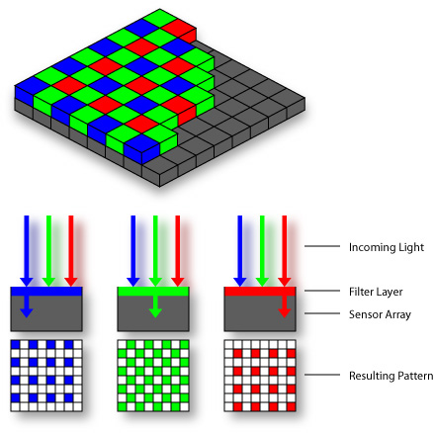

Color Sensing: Bayer Grid
Estimate RGB at each cell from neighboring values
http://en.wikipedia.org/wiki/Bayer_filter
Slide by Steve Seitz

Slide 10
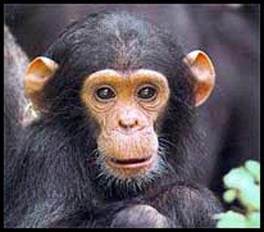
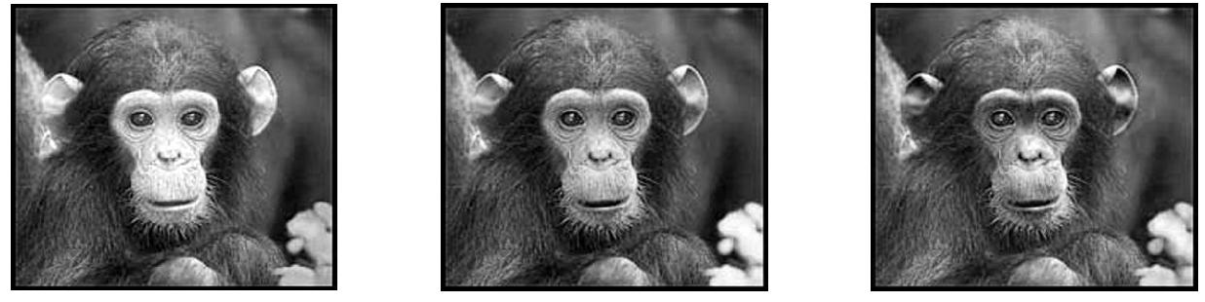
Digital color images
Color images, RGB color space
R
G
B
Slide credit: Kristen Grauman

Slide 11
Images in Matlab
Images represented as a matrix
Suppose we have an NxM RGB image called “im”
im(1,1,1) = top-left pixel value in R-channel
im(y, x, b) = y pixels down, x pixels to right in the b^{th} channel
im(N, M, 3) = bottom-right pixel in B-channel
imread(filename) returns a uint8 image (values 0 to 255)
Convert to double format (values 0 to 1) with im2double
column
row
R
0.92 | 0.93 | 0.94 | 0.97 | 0.62 | 0.37 | 0.85 | 0.97 | 0.93 | 0.92 | 0.99
0.95 | 0.89 | 0.82 | 0.89 | 0.56 | 0.31 | 0.75 | 0.92 | 0.81 | 0.95 | 0.91
0.89 | 0.72 | 0.51 | 0.55 | 0.51 | 0.42 | 0.57 | 0.41 | 0.49 | 0.91 | 0.92
0.96 | 0.95 | 0.88 | 0.94 | 0.56 | 0.46 | 0.91 | 0.87 | 0.90 | 0.97 | 0.95
0.71 | 0.81 | 0.81 | 0.87 | 0.57 | 0.37 | 0.80 | 0.88 | 0.89 | 0.79 | 0.85
0.49 | 0.62 | 0.60 | 0.58 | 0.50 | 0.60 | 0.58 | 0.50 | 0.61 | 0.45 | 0.33
0.86 | 0.84 | 0.74 | 0.58 | 0.51 | 0.39 | 0.73 | 0.92 | 0.91 | 0.49 | 0.74
0.96 | 0.67 | 0.54 | 0.85 | 0.48 | 0.37 | 0.88 | 0.90 | 0.94 | 0.82 | 0.93
0.69 | 0.49 | 0.56 | 0.66 | 0.43 | 0.42 | 0.77 | 0.73 | 0.71 | 0.90 | 0.99
0.79 | 0.73 | 0.90 | 0.67 | 0.33 | 0.61 | 0.69 | 0.79 | 0.73 | 0.93 | 0.97
0.91 | 0.94 | 0.89 | 0.49 | 0.41 | 0.78 | 0.78 | 0.77 | 0.89 | 0.99 | 0.93
G
0.92 | 0.93 | 0.94 | 0.97 | 0.62 | 0.37 | 0.85 | 0.97 | 0.93 | 0.92 | 0.99
0.95 | 0.89 | 0.82 | 0.89 | 0.56 | 0.31 | 0.75 | 0.92 | 0.81 | 0.95 | 0.91
0.89 | 0.72 | 0.51 | 0.55 | 0.51 | 0.42 | 0.57 | 0.41 | 0.49 | 0.91 | 0.92
0.96 | 0.95 | 0.88 | 0.94 | 0.56 | 0.46 | 0.91 | 0.87 | 0.90 | 0.97 | 0.95
0.71 | 0.81 | 0.81 | 0.87 | 0.57 | 0.37 | 0.80 | 0.88 | 0.89 | 0.79 | 0.85
0.49 | 0.62 | 0.60 | 0.58 | 0.50 | 0.60 | 0.58 | 0.50 | 0.61 | 0.45 | 0.33
0.86 | 0.84 | 0.74 | 0.58 | 0.51 | 0.39 | 0.73 | 0.92 | 0.91 | 0.49 | 0.74
0.96 | 0.67 | 0.54 | 0.85 | 0.48 | 0.37 | 0.88 | 0.90 | 0.94 | 0.82 | 0.93
0.69 | 0.49 | 0.56 | 0.66 | 0.43 | 0.42 | 0.77 | 0.73 | 0.71 | 0.90 | 0.99
0.79 | 0.73 | 0.90 | 0.67 | 0.33 | 0.61 | 0.69 | 0.79 | 0.73 | 0.93 | 0.97
0.91 | 0.94 | 0.89 | 0.49 | 0.41 | 0.78 | 0.78 | 0.77 | 0.89 | 0.99 | 0.93
B
0.92 | 0.93 | 0.94 | 0.97 | 0.62 | 0.37 | 0.85 | 0.97 | 0.93 | 0.92 | 0.99
0.95 | 0.89 | 0.82 | 0.89 | 0.56 | 0.31 | 0.75 | 0.92 | 0.81 | 0.95 | 0.91
0.89 | 0.72 | 0.51 | 0.55 | 0.51 | 0.42 | 0.57 | 0.41 | 0.49 | 0.91 | 0.92
0.96 | 0.95 | 0.88 | 0.94 | 0.56 | 0.46 | 0.91 | 0.87 | 0.90 | 0.97 | 0.95
0.71 | 0.81 | 0.81 | 0.87 | 0.57 | 0.37 | 0.80 | 0.88 | 0.89 | 0.79 | 0.85
0.49 | 0.62 | 0.60 | 0.58 | 0.50 | 0.60 | 0.58 | 0.50 | 0.61 | 0.45 | 0.33
0.86 | 0.84 | 0.74 | 0.58 | 0.51 | 0.39 | 0.73 | 0.92 | 0.91 | 0.49 | 0.74
0.96 | 0.67 | 0.54 | 0.85 | 0.48 | 0.37 | 0.88 | 0.90 | 0.94 | 0.82 | 0.93
0.69 | 0.49 | 0.56 | 0.66 | 0.43 | 0.42 | 0.77 | 0.73 | 0.71 | 0.90 | 0.99
0.79 | 0.73 | 0.90 | 0.67 | 0.33 | 0.61 | 0.69 | 0.79 | 0.73 | 0.93 | 0.97
0.91 | 0.94 | 0.89 | 0.49 | 0.41 | 0.78 | 0.78 | 0.77 | 0.89 | 0.99 | 0.93
Slide credit: Derek Hoiem
Notes:
Floating point operations

Slide 12
Image filtering
Compute a function of the local neighborhood at each pixel in the image
Function specified by a “filter” or mask saying how to combine values from neighbors
Uses of filtering:
Enhance an image (denoise, resize, increase contrast, etc)
Extract information (texture, edges, interest points, etc)
Detect patterns (template matching)
Slide credit: Kristen Grauman, Adapted from Derek Hoiem
Notes:
1st stage in most CV applications; img processing converts img into more suitable form for further analysis.

Slide 13
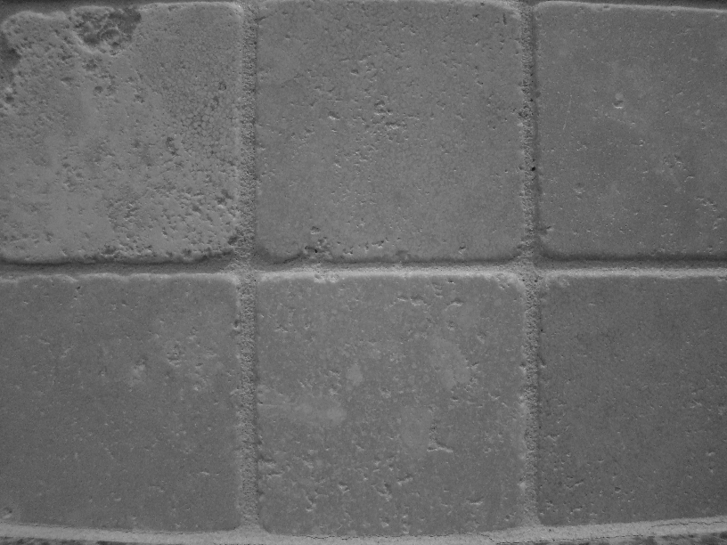
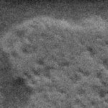
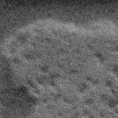

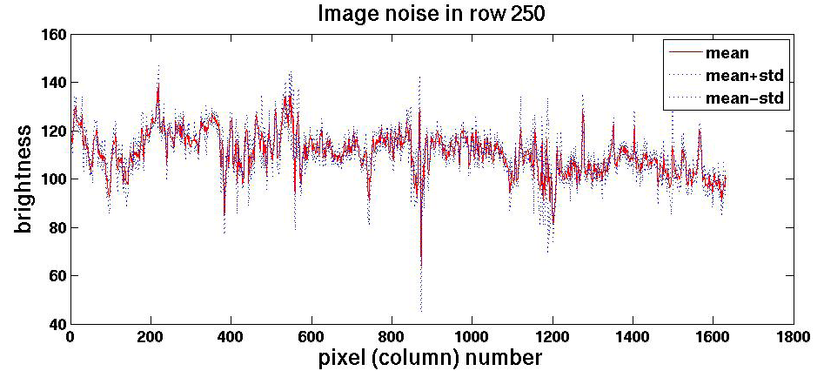
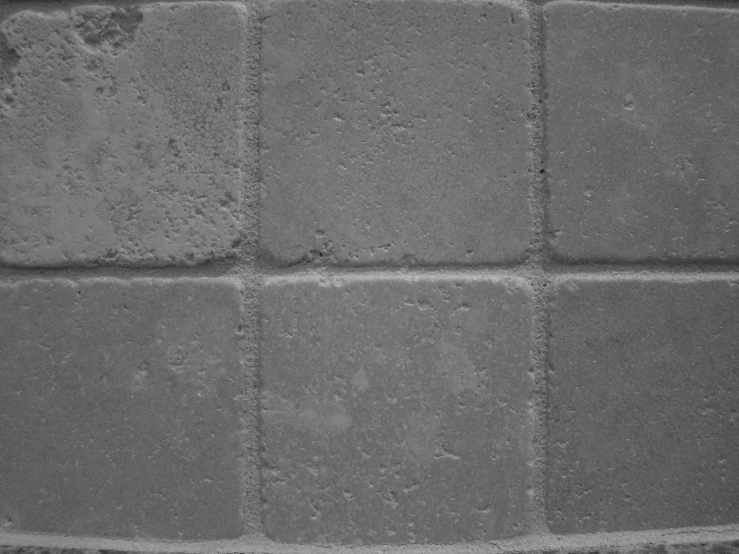
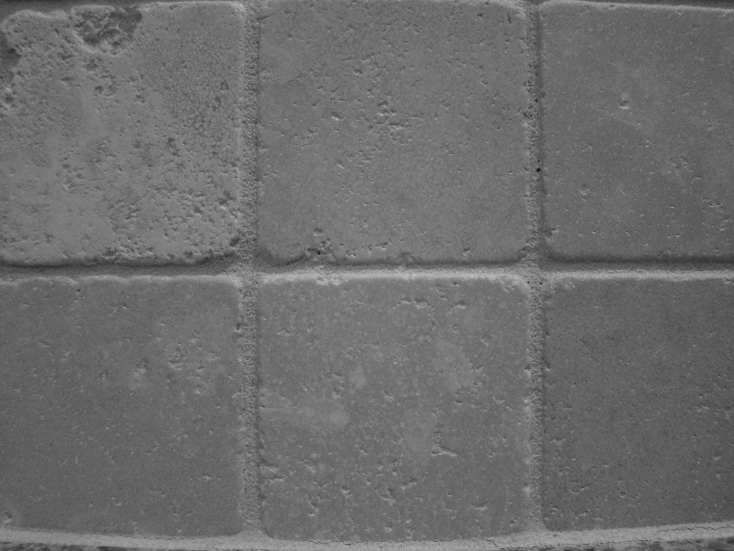


Motivation: noise reduction
Even multiple images of the same static scene will not be identical.
Slide adapted from Kristen Grauman

Slide 14
Common types of noise
Salt and pepper noise: random occurrences of black and white pixels
Impulse noise: random occurrences of white pixels
Gaussian noise: variations in intensity drawn from a Gaussian normal distribution
Slide credit: Steve Seitz

Slide 15
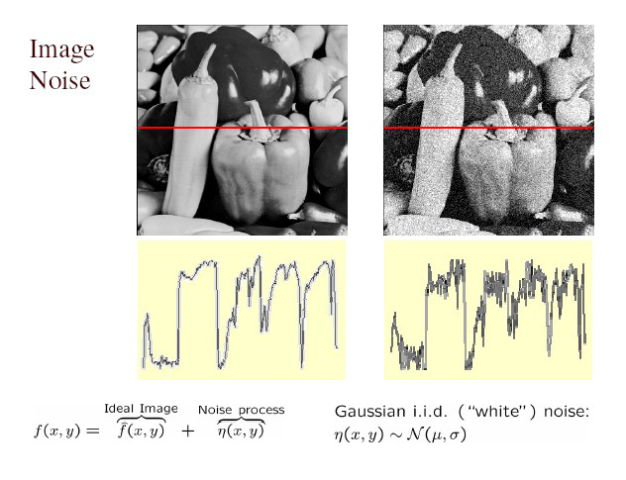
Gaussian noise
>> noise = randn(size(im)).*sigma;
>> output = im + noise;
What is impact of the sigma?
Figure from Martial Hebert

Slide 16
Motivation: noise reduction
Even multiple images of the same static scene will not be identical.
How could we reduce the noise, i.e., give an estimate of the true intensities?
What if there’s only one image?
Slide credit: Kristen Grauman

Slide 17
First attempt at a solution
Let’s replace each pixel with an average of all the values in its neighborhood
Assumptions:
Expect pixels to be like their neighbors
Expect noise processes to be independent from pixel to pixel
Slide credit: Kristen Grauman

Slide 18
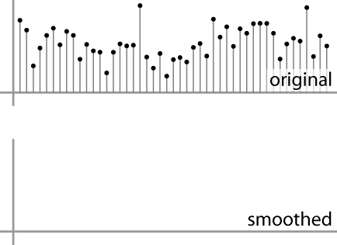
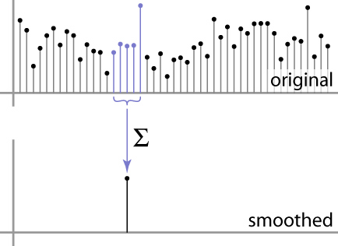
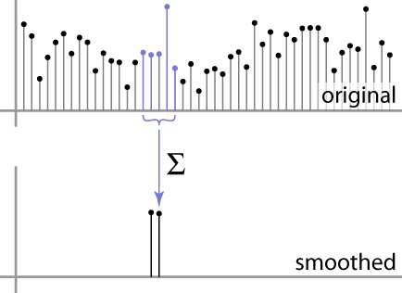
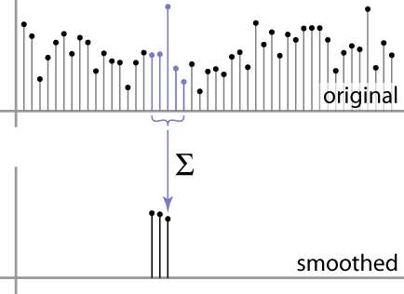
First attempt at a solution
Let’s replace each pixel with an average of all the values in its neighborhood
Moving average in 1D:
Slide credit: S. Marschner

Slide 19
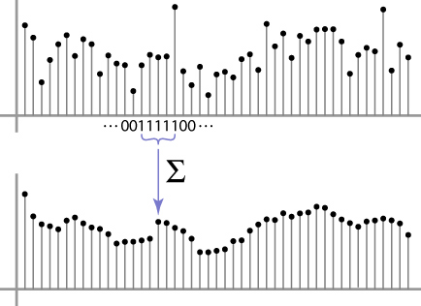
Weighted Moving Average
Can add weights to our moving average
Weights [1, 1, 1, 1, 1] / 5
Slide credit: S. Marschner

Slide 20

Weighted Moving Average
Non-uniform weights [1, 4, 6, 4, 1] / 16
Slide credit: S. Marschner

Slide 21
Moving Average In 2D
0 | 0 | 0 | 0 | 0 | 0 | 0 | 0 | 0 | 0
0 | 0 | 0 | 0 | 0 | 0 | 0 | 0 | 0 | 0
0 | 0 | 0 | 90 | 90 | 90 | 90 | 90 | 0 | 0
0 | 0 | 0 | 90 | 90 | 90 | 90 | 90 | 0 | 0
0 | 0 | 0 | 90 | 90 | 90 | 90 | 90 | 0 | 0
0 | 0 | 0 | 90 | 0 | 90 | 90 | 90 | 0 | 0
0 | 0 | 0 | 90 | 90 | 90 | 90 | 90 | 0 | 0
0 | 0 | 0 | 0 | 0 | 0 | 0 | 0 | 0 | 0
0 | 0 | 90 | 0 | 0 | 0 | 0 | 0 | 0 | 0
0 | 0 | 0 | 0 | 0 | 0 | 0 | 0 | 0 | 0
0 | 0 | 0 | 0 | 0 | 0 | 0 | 0 | 0 | 0
0 | 0 | 0 | 0 | 0 | 0 | 0 | 0 | 0 | 0
0 | 0 | 0 | 90 | 90 | 90 | 90 | 90 | 0 | 0
0 | 0 | 0 | 90 | 90 | 90 | 90 | 90 | 0 | 0
0 | 0 | 0 | 90 | 90 | 90 | 90 | 90 | 0 | 0
0 | 0 | 0 | 90 | 0 | 90 | 90 | 90 | 0 | 0
0 | 0 | 0 | 90 | 90 | 90 | 90 | 90 | 0 | 0
0 | 0 | 0 | 0 | 0 | 0 | 0 | 0 | 0 | 0
0 | 0 | 90 | 0 | 0 | 0 | 0 | 0 | 0 | 0
0 | 0 | 0 | 0 | 0 | 0 | 0 | 0 | 0 | 0
Slide credit: Steve Seitz

Slide 22
Moving Average In 2D
0 | 0 | 0 | 0 | 0 | 0 | 0 | 0 | 0 | 0
0 | 0 | 0 | 0 | 0 | 0 | 0 | 0 | 0 | 0
0 | 0 | 0 | 90 | 90 | 90 | 90 | 90 | 0 | 0
0 | 0 | 0 | 90 | 90 | 90 | 90 | 90 | 0 | 0
0 | 0 | 0 | 90 | 90 | 90 | 90 | 90 | 0 | 0
0 | 0 | 0 | 90 | 0 | 90 | 90 | 90 | 0 | 0
0 | 0 | 0 | 90 | 90 | 90 | 90 | 90 | 0 | 0
0 | 0 | 0 | 0 | 0 | 0 | 0 | 0 | 0 | 0
0 | 0 | 90 | 0 | 0 | 0 | 0 | 0 | 0 | 0
0 | 0 | 0 | 0 | 0 | 0 | 0 | 0 | 0 | 0
 | 0
0 | 0 | 0 | 0 | 0 | 0 | 0 | 0 | 0 | 0
0 | 0 | 0 | 0 | 0 | 0 | 0 | 0 | 0 | 0
0 | 0 | 0 | 90 | 90 | 90 | 90 | 90 | 0 | 0
0 | 0 | 0 | 90 | 90 | 90 | 90 | 90 | 0 | 0
0 | 0 | 0 | 90 | 90 | 90 | 90 | 90 | 0 | 0
0 | 0 | 0 | 90 | 0 | 90 | 90 | 90 | 0 | 0
0 | 0 | 0 | 90 | 90 | 90 | 90 | 90 | 0 | 0
0 | 0 | 0 | 0 | 0 | 0 | 0 | 0 | 0 | 0
0 | 0 | 90 | 0 | 0 | 0 | 0 | 0 | 0 | 0
0 | 0 | 0 | 0 | 0 | 0 | 0 | 0 | 0 | 0
Slide credit: Steve Seitz

Slide 23
Moving Average In 2D
0 | 0 | 0 | 0 | 0 | 0 | 0 | 0 | 0 | 0
0 | 0 | 0 | 0 | 0 | 0 | 0 | 0 | 0 | 0
0 | 0 | 0 | 90 | 90 | 90 | 90 | 90 | 0 | 0
0 | 0 | 0 | 90 | 90 | 90 | 90 | 90 | 0 | 0
0 | 0 | 0 | 90 | 90 | 90 | 90 | 90 | 0 | 0
0 | 0 | 0 | 90 | 0 | 90 | 90 | 90 | 0 | 0
0 | 0 | 0 | 90 | 90 | 90 | 90 | 90 | 0 | 0
0 | 0 | 0 | 0 | 0 | 0 | 0 | 0 | 0 | 0
0 | 0 | 90 | 0 | 0 | 0 | 0 | 0 | 0 | 0
0 | 0 | 0 | 0 | 0 | 0 | 0 | 0 | 0 | 0
 | 0
0 | 0 | 0 | 0 | 0 | 0 | 0 | 0 | 0 | 0
0 | 0 | 0 | 0 | 0 | 0 | 0 | 0 | 0 | 0
0 | 0 | 0 | 90 | 90 | 90 | 90 | 90 | 0 | 0
0 | 0 | 0 | 90 | 90 | 90 | 90 | 90 | 0 | 0
0 | 0 | 0 | 90 | 90 | 90 | 90 | 90 | 0 | 0
0 | 0 | 0 | 90 | 0 | 90 | 90 | 90 | 0 | 0
0 | 0 | 0 | 90 | 90 | 90 | 90 | 90 | 0 | 0
0 | 0 | 0 | 0 | 0 | 0 | 0 | 0 | 0 | 0
0 | 0 | 90 | 0 | 0 | 0 | 0 | 0 | 0 | 0
0 | 0 | 0 | 0 | 0 | 0 | 0 | 0 | 0 | 0
Slide credit: Steve Seitz

Slide 24
Moving Average In 2D
0 | 0 | 0 | 0 | 0 | 0 | 0 | 0 | 0 | 0
0 | 0 | 0 | 0 | 0 | 0 | 0 | 0 | 0 | 0
0 | 0 | 0 | 90 | 90 | 90 | 90 | 90 | 0 | 0
0 | 0 | 0 | 90 | 90 | 90 | 90 | 90 | 0 | 0
0 | 0 | 0 | 90 | 90 | 90 | 90 | 90 | 0 | 0
0 | 0 | 0 | 90 | 0 | 90 | 90 | 90 | 0 | 0
0 | 0 | 0 | 90 | 90 | 90 | 90 | 90 | 0 | 0
0 | 0 | 0 | 0 | 0 | 0 | 0 | 0 | 0 | 0
0 | 0 | 90 | 0 | 0 | 0 | 0 | 0 | 0 | 0
0 | 0 | 0 | 0 | 0 | 0 | 0 | 0 | 0 | 0
 | 0 | 10
0 | 0 | 0 | 0 | 0 | 0 | 0 | 0 | 0 | 0
0 | 0 | 0 | 0 | 0 | 0 | 0 | 0 | 0 | 0
0 | 0 | 0 | 90 | 90 | 90 | 90 | 90 | 0 | 0
0 | 0 | 0 | 90 | 90 | 90 | 90 | 90 | 0 | 0
0 | 0 | 0 | 90 | 90 | 90 | 90 | 90 | 0 | 0
0 | 0 | 0 | 90 | 0 | 90 | 90 | 90 | 0 | 0
0 | 0 | 0 | 90 | 90 | 90 | 90 | 90 | 0 | 0
0 | 0 | 0 | 0 | 0 | 0 | 0 | 0 | 0 | 0
0 | 0 | 90 | 0 | 0 | 0 | 0 | 0 | 0 | 0
0 | 0 | 0 | 0 | 0 | 0 | 0 | 0 | 0 | 0
Slide credit: Steve Seitz

Slide 25
Moving Average In 2D
0 | 0 | 0 | 0 | 0 | 0 | 0 | 0 | 0 | 0
0 | 0 | 0 | 0 | 0 | 0 | 0 | 0 | 0 | 0
0 | 0 | 0 | 90 | 90 | 90 | 90 | 90 | 0 | 0
0 | 0 | 0 | 90 | 90 | 90 | 90 | 90 | 0 | 0
0 | 0 | 0 | 90 | 90 | 90 | 90 | 90 | 0 | 0
0 | 0 | 0 | 90 | 0 | 90 | 90 | 90 | 0 | 0
0 | 0 | 0 | 90 | 90 | 90 | 90 | 90 | 0 | 0
0 | 0 | 0 | 0 | 0 | 0 | 0 | 0 | 0 | 0
0 | 0 | 90 | 0 | 0 | 0 | 0 | 0 | 0 | 0
0 | 0 | 0 | 0 | 0 | 0 | 0 | 0 | 0 | 0
 | 0 | 10
0 | 0 | 0 | 0 | 0 | 0 | 0 | 0 | 0 | 0
0 | 0 | 0 | 0 | 0 | 0 | 0 | 0 | 0 | 0
0 | 0 | 0 | 90 | 90 | 90 | 90 | 90 | 0 | 0
0 | 0 | 0 | 90 | 90 | 90 | 90 | 90 | 0 | 0
0 | 0 | 0 | 90 | 90 | 90 | 90 | 90 | 0 | 0
0 | 0 | 0 | 90 | 0 | 90 | 90 | 90 | 0 | 0
0 | 0 | 0 | 90 | 90 | 90 | 90 | 90 | 0 | 0
0 | 0 | 0 | 0 | 0 | 0 | 0 | 0 | 0 | 0
0 | 0 | 90 | 0 | 0 | 0 | 0 | 0 | 0 | 0
0 | 0 | 0 | 0 | 0 | 0 | 0 | 0 | 0 | 0
Slide credit: Steve Seitz

Slide 26
Moving Average In 2D
0 | 0 | 0 | 0 | 0 | 0 | 0 | 0 | 0 | 0
0 | 0 | 0 | 0 | 0 | 0 | 0 | 0 | 0 | 0
0 | 0 | 0 | 90 | 90 | 90 | 90 | 90 | 0 | 0
0 | 0 | 0 | 90 | 90 | 90 | 90 | 90 | 0 | 0
0 | 0 | 0 | 90 | 90 | 90 | 90 | 90 | 0 | 0
0 | 0 | 0 | 90 | 0 | 90 | 90 | 90 | 0 | 0
0 | 0 | 0 | 90 | 90 | 90 | 90 | 90 | 0 | 0
0 | 0 | 0 | 0 | 0 | 0 | 0 | 0 | 0 | 0
0 | 0 | 90 | 0 | 0 | 0 | 0 | 0 | 0 | 0
0 | 0 | 0 | 0 | 0 | 0 | 0 | 0 | 0 | 0
 | 0 | 10 | 20
0 | 0 | 0 | 0 | 0 | 0 | 0 | 0 | 0 | 0
0 | 0 | 0 | 0 | 0 | 0 | 0 | 0 | 0 | 0
0 | 0 | 0 | 90 | 90 | 90 | 90 | 90 | 0 | 0
0 | 0 | 0 | 90 | 90 | 90 | 90 | 90 | 0 | 0
0 | 0 | 0 | 90 | 90 | 90 | 90 | 90 | 0 | 0
0 | 0 | 0 | 90 | 0 | 90 | 90 | 90 | 0 | 0
0 | 0 | 0 | 90 | 90 | 90 | 90 | 90 | 0 | 0
0 | 0 | 0 | 0 | 0 | 0 | 0 | 0 | 0 | 0
0 | 0 | 90 | 0 | 0 | 0 | 0 | 0 | 0 | 0
0 | 0 | 0 | 0 | 0 | 0 | 0 | 0 | 0 | 0
Slide credit: Steve Seitz

Slide 27
Moving Average In 2D
0 | 0 | 0 | 0 | 0 | 0 | 0 | 0 | 0 | 0
0 | 0 | 0 | 0 | 0 | 0 | 0 | 0 | 0 | 0
0 | 0 | 0 | 90 | 90 | 90 | 90 | 90 | 0 | 0
0 | 0 | 0 | 90 | 90 | 90 | 90 | 90 | 0 | 0
0 | 0 | 0 | 90 | 90 | 90 | 90 | 90 | 0 | 0
0 | 0 | 0 | 90 | 0 | 90 | 90 | 90 | 0 | 0
0 | 0 | 0 | 90 | 90 | 90 | 90 | 90 | 0 | 0
0 | 0 | 0 | 0 | 0 | 0 | 0 | 0 | 0 | 0
0 | 0 | 90 | 0 | 0 | 0 | 0 | 0 | 0 | 0
0 | 0 | 0 | 0 | 0 | 0 | 0 | 0 | 0 | 0
 | 0 | 10 | 20
0 | 0 | 0 | 0 | 0 | 0 | 0 | 0 | 0 | 0
0 | 0 | 0 | 0 | 0 | 0 | 0 | 0 | 0 | 0
0 | 0 | 0 | 90 | 90 | 90 | 90 | 90 | 0 | 0
0 | 0 | 0 | 90 | 90 | 90 | 90 | 90 | 0 | 0
0 | 0 | 0 | 90 | 90 | 90 | 90 | 90 | 0 | 0
0 | 0 | 0 | 90 | 0 | 90 | 90 | 90 | 0 | 0
0 | 0 | 0 | 90 | 90 | 90 | 90 | 90 | 0 | 0
0 | 0 | 0 | 0 | 0 | 0 | 0 | 0 | 0 | 0
0 | 0 | 90 | 0 | 0 | 0 | 0 | 0 | 0 | 0
0 | 0 | 0 | 0 | 0 | 0 | 0 | 0 | 0 | 0
Slide credit: Steve Seitz

Slide 28
Moving Average In 2D
0 | 0 | 0 | 0 | 0 | 0 | 0 | 0 | 0 | 0
0 | 0 | 0 | 0 | 0 | 0 | 0 | 0 | 0 | 0
0 | 0 | 0 | 90 | 90 | 90 | 90 | 90 | 0 | 0
0 | 0 | 0 | 90 | 90 | 90 | 90 | 90 | 0 | 0
0 | 0 | 0 | 90 | 90 | 90 | 90 | 90 | 0 | 0
0 | 0 | 0 | 90 | 0 | 90 | 90 | 90 | 0 | 0
0 | 0 | 0 | 90 | 90 | 90 | 90 | 90 | 0 | 0
0 | 0 | 0 | 0 | 0 | 0 | 0 | 0 | 0 | 0
0 | 0 | 90 | 0 | 0 | 0 | 0 | 0 | 0 | 0
0 | 0 | 0 | 0 | 0 | 0 | 0 | 0 | 0 | 0
 | 0 | 10 | 20 | 30
0 | 0 | 0 | 0 | 0 | 0 | 0 | 0 | 0 | 0
0 | 0 | 0 | 0 | 0 | 0 | 0 | 0 | 0 | 0
0 | 0 | 0 | 90 | 90 | 90 | 90 | 90 | 0 | 0
0 | 0 | 0 | 90 | 90 | 90 | 90 | 90 | 0 | 0
0 | 0 | 0 | 90 | 90 | 90 | 90 | 90 | 0 | 0
0 | 0 | 0 | 90 | 0 | 90 | 90 | 90 | 0 | 0
0 | 0 | 0 | 90 | 90 | 90 | 90 | 90 | 0 | 0
0 | 0 | 0 | 0 | 0 | 0 | 0 | 0 | 0 | 0
0 | 0 | 90 | 0 | 0 | 0 | 0 | 0 | 0 | 0
0 | 0 | 0 | 0 | 0 | 0 | 0 | 0 | 0 | 0
Slide credit: Steve Seitz

Slide 29
Moving Average In 2D
0 | 0 | 0 | 0 | 0 | 0 | 0 | 0 | 0 | 0
0 | 0 | 0 | 0 | 0 | 0 | 0 | 0 | 0 | 0
0 | 0 | 0 | 90 | 90 | 90 | 90 | 90 | 0 | 0
0 | 0 | 0 | 90 | 90 | 90 | 90 | 90 | 0 | 0
0 | 0 | 0 | 90 | 90 | 90 | 90 | 90 | 0 | 0
0 | 0 | 0 | 90 | 0 | 90 | 90 | 90 | 0 | 0
0 | 0 | 0 | 90 | 90 | 90 | 90 | 90 | 0 | 0
0 | 0 | 0 | 0 | 0 | 0 | 0 | 0 | 0 | 0
0 | 0 | 90 | 0 | 0 | 0 | 0 | 0 | 0 | 0
0 | 0 | 0 | 0 | 0 | 0 | 0 | 0 | 0 | 0
 | 0 | 10 | 20 | 30
Slide credit: Steve Seitz

Slide 30
Moving Average In 2D
0 | 0 | 0 | 0 | 0 | 0 | 0 | 0 | 0 | 0
0 | 0 | 0 | 0 | 0 | 0 | 0 | 0 | 0 | 0
0 | 0 | 0 | 90 | 90 | 90 | 90 | 90 | 0 | 0
0 | 0 | 0 | 90 | 90 | 90 | 90 | 90 | 0 | 0
0 | 0 | 0 | 90 | 90 | 90 | 90 | 90 | 0 | 0
0 | 0 | 0 | 90 | 0 | 90 | 90 | 90 | 0 | 0
0 | 0 | 0 | 90 | 90 | 90 | 90 | 90 | 0 | 0
0 | 0 | 0 | 0 | 0 | 0 | 0 | 0 | 0 | 0
0 | 0 | 90 | 0 | 0 | 0 | 0 | 0 | 0 | 0
0 | 0 | 0 | 0 | 0 | 0 | 0 | 0 | 0 | 0
 | 0 | 10 | 20 | 30 | 30
Slide credit: Steve Seitz

Slide 31
Moving Average In 2D
0 | 0 | 0 | 0 | 0 | 0 | 0 | 0 | 0 | 0
0 | 0 | 0 | 0 | 0 | 0 | 0 | 0 | 0 | 0
0 | 0 | 0 | 90 | 90 | 90 | 90 | 90 | 0 | 0
0 | 0 | 0 | 90 | 90 | 90 | 90 | 90 | 0 | 0
0 | 0 | 0 | 90 | 90 | 90 | 90 | 90 | 0 | 0
0 | 0 | 0 | 90 | 0 | 90 | 90 | 90 | 0 | 0
0 | 0 | 0 | 90 | 90 | 90 | 90 | 90 | 0 | 0
0 | 0 | 0 | 0 | 0 | 0 | 0 | 0 | 0 | 0
0 | 0 | 90 | 0 | 0 | 0 | 0 | 0 | 0 | 0
0 | 0 | 0 | 0 | 0 | 0 | 0 | 0 | 0 | 0
 | 0 | 10 | 20 | 30 | 30 | 30 | 20 | 10
 | 0 | 20 | 40 | 60 | 60 | 60 | 40 | 20
 | 0 | 30 | 60 | 90 | 90 | 90 | 60 | 30
 | 0 | 30 | 50 | 80 | 80 | 90 | 60 | 30
 | 0 | 30 | 50 | 80 | 80 | 90 | 60 | 30
 | 0 | 20 | 30 | 50 | 50 | 60 | 40 | 20
 | 10 | 20 | 30 | 30 | 30 | 30 | 20 | 10
 | 10 | 10 | 10 | 0 | 0 | 0 | 0 | 0
Slide credit: Steve Seitz

Slide 32
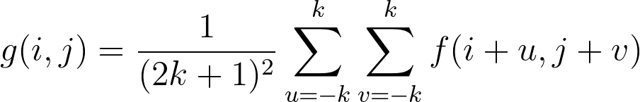
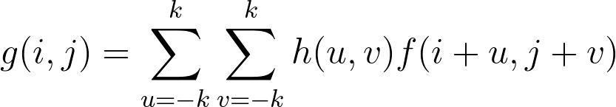
Correlation filtering
Say the averaging window size is 2k+1 x 2k+1:
Attribute uniform weight to each pixel
Loop over all pixels in neighborhood around image pixel f[i,j]
Now generalize to allow different weights depending on neighboring pixel’s relative position:
Non-uniform weights
Slide adapted from Kristen Grauman

Slide 33
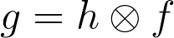
Correlation filtering
This is called cross-correlation, denoted
Filtering an image: replace each pixel with a linear combination of its neighbors.
The filter “kernel” or “mask” h[u,v] is the prescription for the weights in the linear combination.
Slide adapted from Kristen Grauman
Notes:
Linear filtering: weighted combination of pixels in a small neighborhood

Slide 34
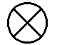

Averaging filter
What values belong in the kernel h for the moving average example?
0 | 0 | 0 | 0 | 0 | 0 | 0 | 0 | 0 | 0
0 | 0 | 0 | 0 | 0 | 0 | 0 | 0 | 0 | 0
0 | 0 | 0 | 90 | 90 | 90 | 90 | 90 | 0 | 0
0 | 0 | 0 | 90 | 90 | 90 | 90 | 90 | 0 | 0
0 | 0 | 0 | 90 | 90 | 90 | 90 | 90 | 0 | 0
0 | 0 | 0 | 90 | 0 | 90 | 90 | 90 | 0 | 0
0 | 0 | 0 | 90 | 90 | 90 | 90 | 90 | 0 | 0
0 | 0 | 0 | 0 | 0 | 0 | 0 | 0 | 0 | 0
0 | 0 | 90 | 0 | 0 | 0 | 0 | 0 | 0 | 0
0 | 0 | 0 | 0 | 0 | 0 | 0 | 0 | 0 | 0
 | 0 | 10 | 20 | 30 | 30
1
1
1
1
?
1
1
1
1
1
“box filter”
Slide adapted from Kristen Grauman

Slide 35
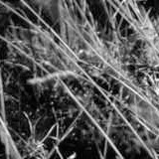
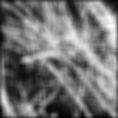
Smoothing by averaging
depicts box filter:
white = high value, black = low value
original
filtered
What if the filter size was 5 x 5 instead of 3 x 3?
Slide credit: Kristen Grauman

Slide 36
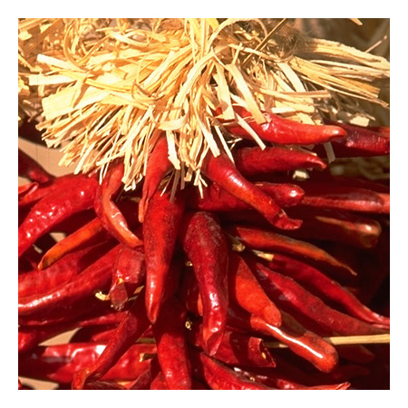
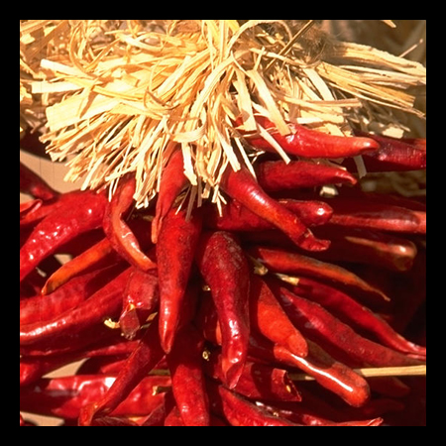

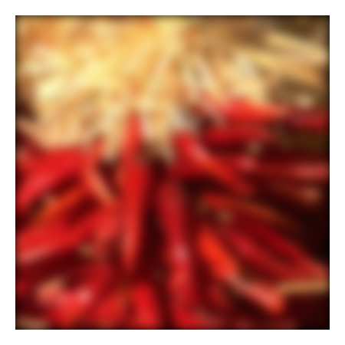
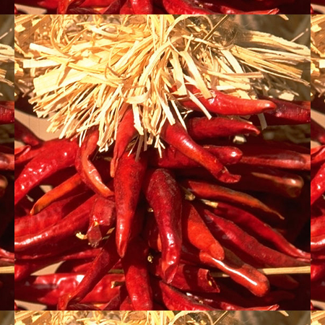

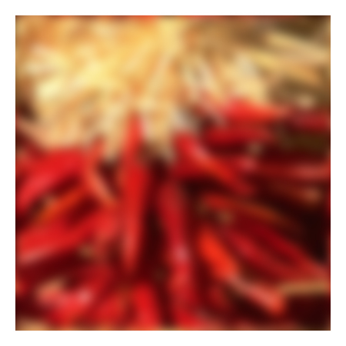
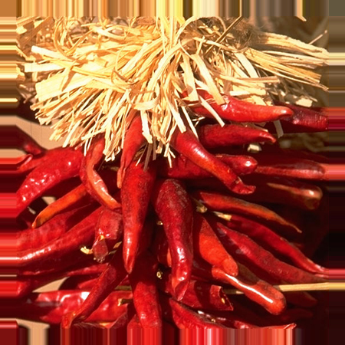


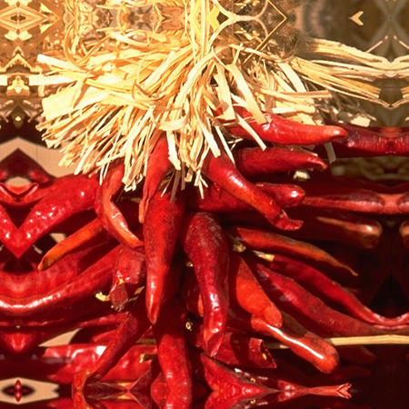


Boundary issues
What about near the edge?
the filter window falls off the edge of the image
need to extrapolate
methods:
clip filter (black)
wrap around
copy edge
reflect across edge
Slide credit: S. Marschner

Slide 37
Boundary issues
What about near the edge?
the filter window falls off the edge of the image
need to extrapolate
methods (MATLAB):
clip filter (black): imfilter(f, g, 0)
wrap around: imfilter(f, g, ‘circular’)
copy edge: imfilter(f, g, ‘replicate’)
reflect across edge: imfilter(f, g, ‘symmetric’)
Slide credit: S. Marschner

Slide 38
Boundary issues
What is the size of the output?
MATLAB: output size / “shape” options
shape = ‘full’: output size is sum of sizes of f and g
shape = ‘same’: output size is same as f
shape = ‘valid’: output size is difference of sizes of f and g
full
same
valid
g
g
g
g
f
f
f
g
g
g
g
g
g
g
g
Slide credit: Svetlana Lazebnik

Slide 39
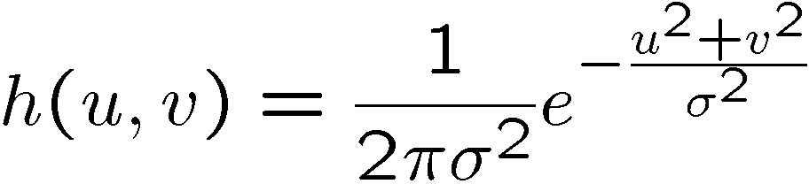
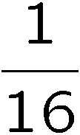
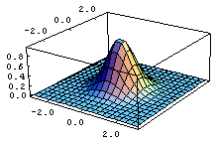
Gaussian filter
What if we want nearest neighboring pixels to have the most influence on the output?
Removes high-frequency components from the image (“low-pass filter”).
This kernel is an approximation of a 2d Gaussian function:
0 | 0 | 0 | 0 | 0 | 0 | 0 | 0 | 0 | 0
0 | 0 | 0 | 0 | 0 | 0 | 0 | 0 | 0 | 0
0 | 0 | 0 | 90 | 90 | 90 | 90 | 90 | 0 | 0
0 | 0 | 0 | 90 | 90 | 90 | 90 | 90 | 0 | 0
0 | 0 | 0 | 90 | 90 | 90 | 90 | 90 | 0 | 0
0 | 0 | 0 | 90 | 0 | 90 | 90 | 90 | 0 | 0
0 | 0 | 0 | 90 | 90 | 90 | 90 | 90 | 0 | 0
0 | 0 | 0 | 0 | 0 | 0 | 0 | 0 | 0 | 0
0 | 0 | 90 | 0 | 0 | 0 | 0 | 0 | 0 | 0
0 | 0 | 0 | 0 | 0 | 0 | 0 | 0 | 0 | 0
1 | 2 | 1
2 | 4 | 2
1 | 2 | 1
Slide credit: Steve Seitz

Slide 40

Smoothing with a Gaussian

Slide 41
Smoothing with a box-filter

Slide 42
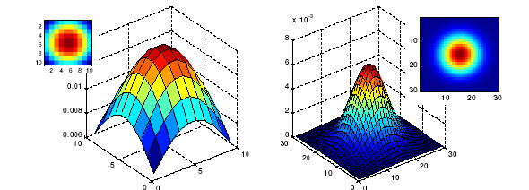
Gaussian filters
What parameters matter here?
Size of kernel or mask
Note, Gaussian function has infinite support, but discrete filters use finite kernels
σ = 5 with 10 x 10 kernel
σ = 5 with 30 x 30 kernel
Slide credit: Kristen Grauman

Slide 43
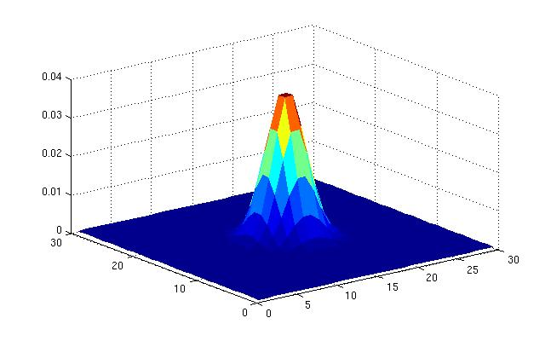
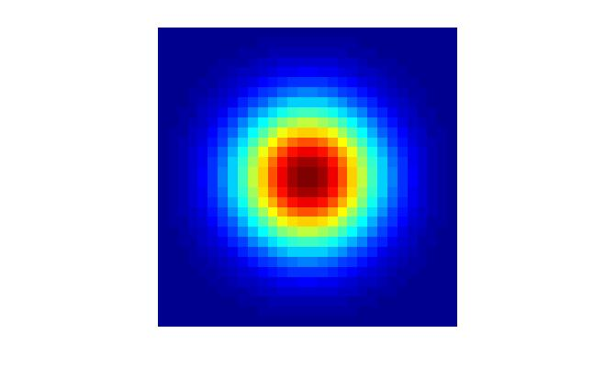
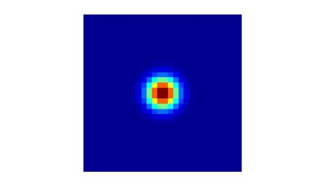
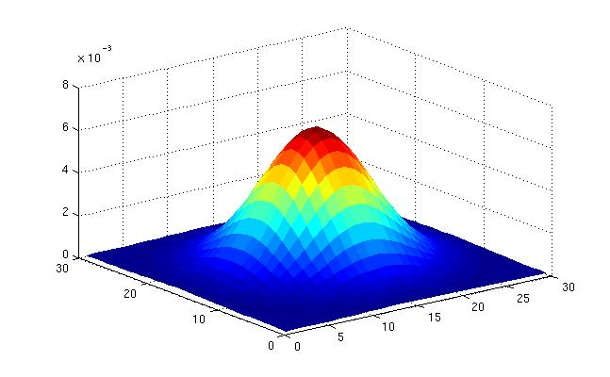
Gaussian filters
What parameters matter here?
Variance of Gaussian: determines extent of smoothing
σ = 2 with 30 x 30 kernel
σ = 5 with 30 x 30 kernel
Slide credit: Kristen Grauman

Slide 44

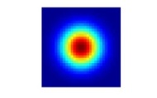
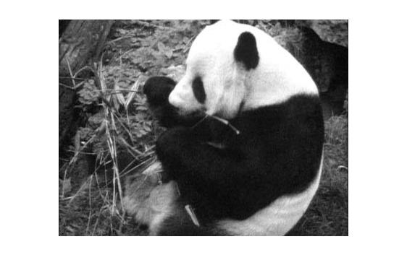
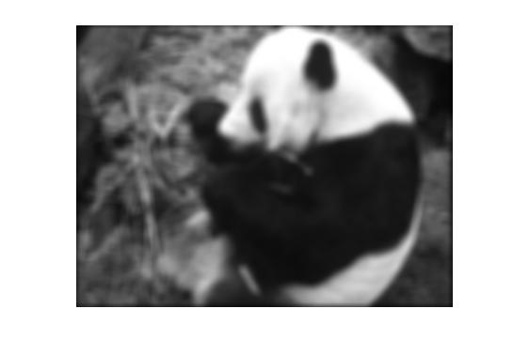
Matlab
>> hsize = 30;
>> sigma = 5;
>> h = fspecial(‘gaussian’, hsize, sigma);
>> mesh(h);
>> imagesc(h);
>> outim = imfilter(im, h); % correlation
>> imshow(outim);
outim
Slide credit: Kristen Grauman
Notes:
In matlab, conv2 does convolution, filter2 does correlation. Imfilter does either if specified, correlation by default (‘conv’, ‘corr’ option)

Slide 45
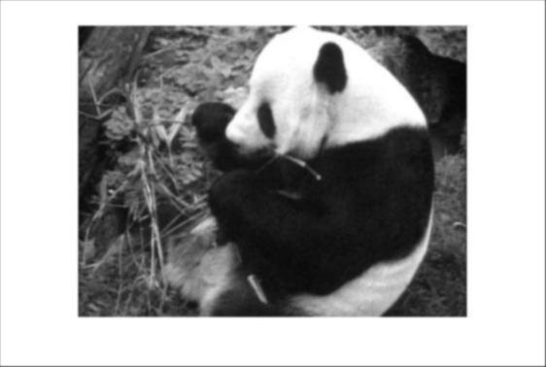
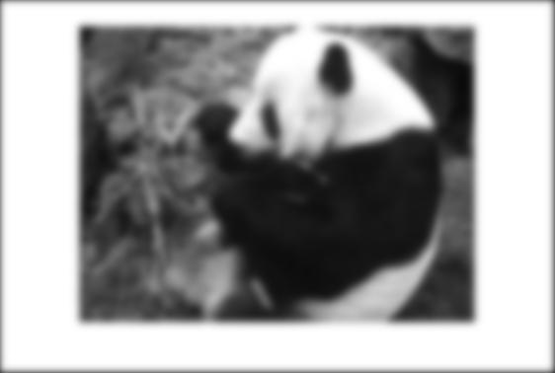
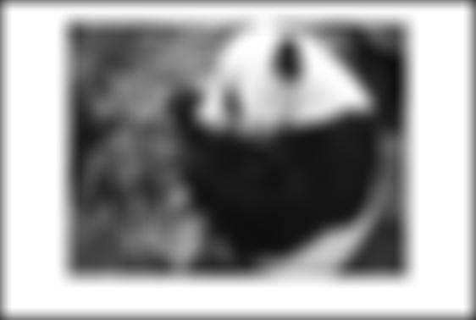
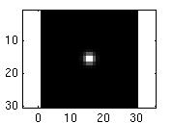
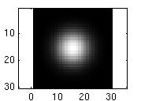
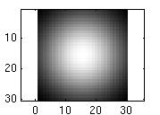
Smoothing with a Gaussian
Parameter σ is the “scale” / “width” / “spread” of the Gaussian kernel, and controls the amount of smoothing.
…
for sigma=1:3:10
h = fspecial('gaussian‘, hsize, sigma);
out = imfilter(im, h);
imshow(out);
pause;
end
Slide credit: Kristen Grauman

Slide 46
Properties of smoothing filters
Smoothing
Values positive
Sum to 1 → constant regions same as input
Amount of smoothing proportional to mask size
Remove “high-frequency” components; “low-pass” filter
Slide credit: Kristen Grauman

Slide 47
Filtering an impulse signal
What is the result of filtering the impulse signal (image) f with the arbitrary kernel h?
0 | 0 | 0 | 0 | 0 | 0 | 0
0 | 0 | 0 | 0 | 0 | 0 | 0
0 | 0 | 0 | 0 | 0 | 0 | 0
0 | 0 | 0 | 1 | 0 | 0 | 0
0 | 0 | 0 | 0 | 0 | 0 | 0
0 | 0 | 0 | 0 | 0 | 0 | 0
0 | 0 | 0 | 0 | 0 | 0 | 0
a | b | c
d | e | f
g | h | i
?
Slide adapted from Kristen Grauman
Notes:
Kernel function h convolved with an impulse signal delta reproduces itself h*delta = h. Correlation produces a reflected signal.

Slide 48


Convolution
Convolution:
Flip the filter in both dimensions (bottom to top, right to left)
Then apply cross-correlation
h
h
f
Notation for convolution operator
Slide adapted from Kristen Grauman

Slide 49
Convolution vs. correlation
Convolution
Cross-correlation
For a Gaussian or box filter, how will the outputs differ?
If the input is an impulse signal, how will the outputs differ?
Slide adapted from Kristen Grauman

Slide 50

Predict the outputs using correlation filtering
0
0
0
0
0
0
*
= ?
*
= ?
0
1
0
0
0
1
0
0
0
0
0
0
0
0
0
-
1
1
1
*
= ?
0
2
0
1
1
1
0
0
0
1
1
1
Slide credit: Kristen Grauman

Slide 51
Practice with linear filters
0
0
0
?
0
1
0
0
0
0
Original
Slide credit: David Lowe

Slide 52
Practice with linear filters
0
0
0
0
1
0
0
0
0
Original
Filtered
(no change)
Slide credit: David Lowe

Slide 53
Practice with linear filters
0
0
0
?
0
0
1
0
0
0
Original
Slide credit: David Lowe

Slide 54
Practice with linear filters
0
0
0
0
0
1
0
0
0
Original
Shifted left
by 1 pixel with correlation
Slide credit: David Lowe

Slide 55
Practice with linear filters
1
1
1
?
1
1
1
1
1
1
Original
Slide credit: David Lowe

Slide 56

Practice with linear filters
1
1
1
1
1
1
1
1
1
Original
Blur (with a
box filter)
Slide credit: David Lowe

Slide 57
Practice with linear filters
0
0
0
-
1
1
1
?
0
2
0
1
1
1
0
0
0
1
1
1
Original
Slide credit: David Lowe

Slide 58


Practice with linear filters
0
0
0
-
1
1
1
0
2
0
1
1
1
0
0
0
1
1
1
Original
Sharpening filter:
accentuates differences with local average
Slide credit: David Lowe

Slide 59

Filtering examples: sharpening
Slide credit: Kristen Grauman

Slide 60
Properties of convolution
Shift invariant:
Operator behaves the same everywhere, i.e. the value of the output depends on the pattern in the image neighborhood, not the position of the neighborhood.
Superposition:
h * (f1 + f2) = (h * f1) + (h * f2)
Slide credit: Kristen Grauman

Slide 61
Properties of convolution
Commutative:
f * g = g * f
Associative
(f * g) * h = f * (g * h)
Distributes over addition
f * (g + h) = (f * g) + (f * h)
Scalars factor out
kf * g = f * kg = k(f * g)
Identity:
unit impulse e = […, 0, 0, 1, 0, 0, …]. f * e = f
Slide credit: Kristen Grauman

Slide 62
Separability
In some cases, filter is separable, and we can factor into two steps:
Convolve all rows
Convolve all columns
Slide credit: Kristen Grauman

Slide 63

Separability
In some cases, filter is separable, and we can factor into two steps: e.g.,
h
What is the computational complexity advantage for a separable filter of size k x k, in terms of number of operations per output pixel?
g
f
f * (g * h) = (f * g) * h
Slide credit: Kristen Grauman
Notes:
k^2 vs. 2k multiply-add per pixel

Slide 64
Effect of smoothing filters
Additive Gaussian noise
Salt and pepper noise
Slide credit: Kristen Grauman

Slide 65

Median filter
No new pixel values introduced
Removes spikes: good for impulse, salt & pepper noise
Non-linear filter
Slide credit: Kristen Grauman
Notes:
Output no longer a weighted summation of input pixels; non-linear filter

Slide 66

Median filter
Salt and pepper noise
Median filtered
Plots of a col of the image
Matlab: output im = medfilt2(im, [h w]);
Slide credit: Martial Hebert

Slide 67

Median filter
Median filter is edge preserving
Slide credit: Kristen Grauman

Slide 68

Filtering application: Hybrid Images
Slide credit: Kristen Grauman
Aude Oliva & Antonio Torralba & Philippe G Schyns, SIGGRAPH 2006
Notes:
\

Slide 69




Application: Hybrid Images
A. Oliva, A. Torralba, P.G. Schyns, “Hybrid Images,” SIGGRAPH 2006
Gaussian Filter
Laplacian Filter
unit impulse
Gaussian
Laplacian of Gaussian
Slide credit: Kristen Grauman

Slide 70

Aude Oliva & Antonio Torralba & Philippe G Schyns, SIGGRAPH 2006

Slide 71

Aude Oliva & Antonio Torralba & Philippe G Schyns, SIGGRAPH 2006

Slide 72
Summary
Image formation
Image “noise”
Linear filters and convolution useful for
Enhancing images (smoothing, removing noise)
Box filter
Gaussian filter
Impact of scale / width of smoothing filter
Detecting features (next time)
Separable filters more efficient
Median filter: a non-linear filter, edge-preserving

Slide 73
Coming up
Next Friday (4/13):
PS0 is due via Canvas, 11:59 PM
Tuesday:
Filtering part 2: filtering for features

Slide 74
Questions?
See you Tuesday!

